Slide 1
Hate week Presents: a Game-Boy Emulator project
By Saahil Sharma

Slide 2

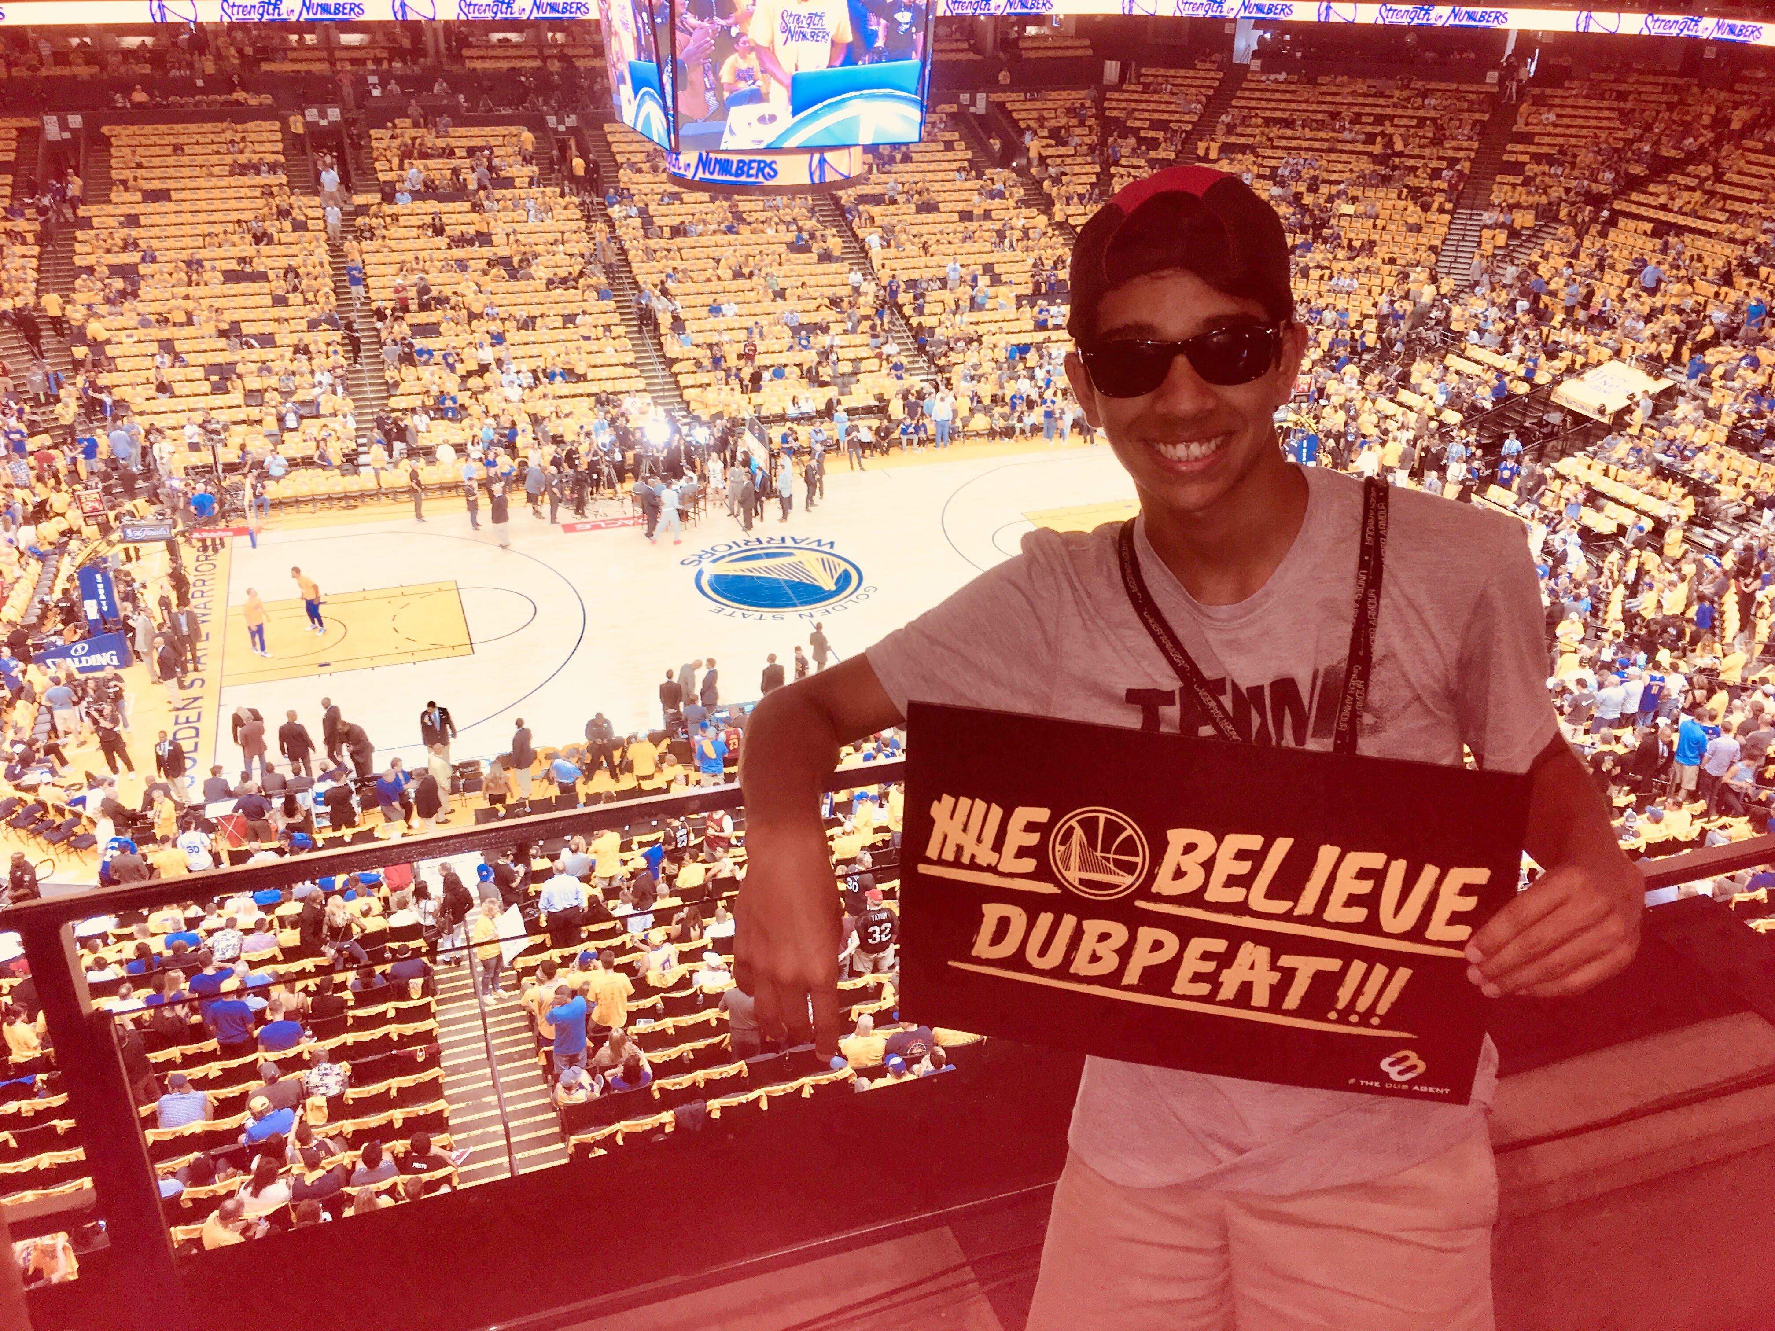

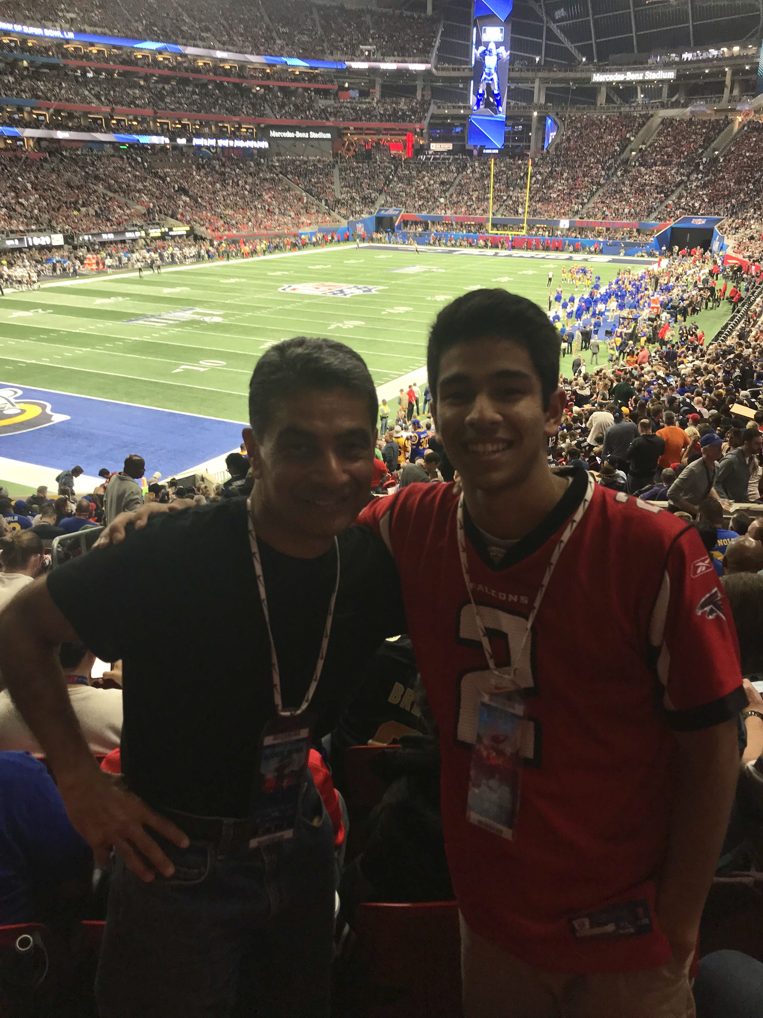
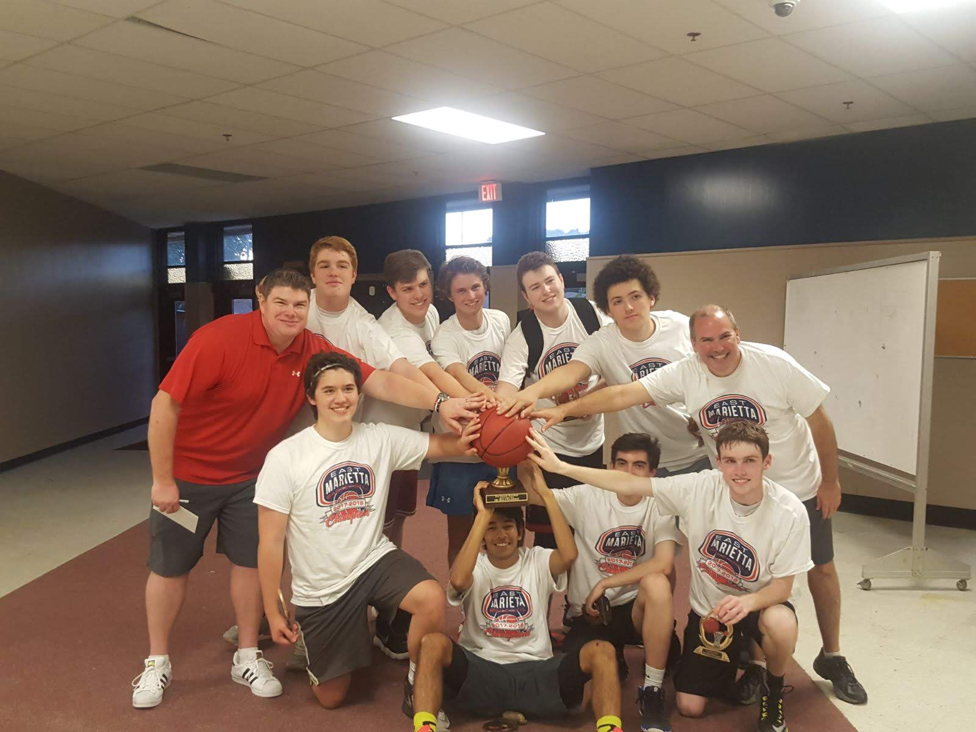
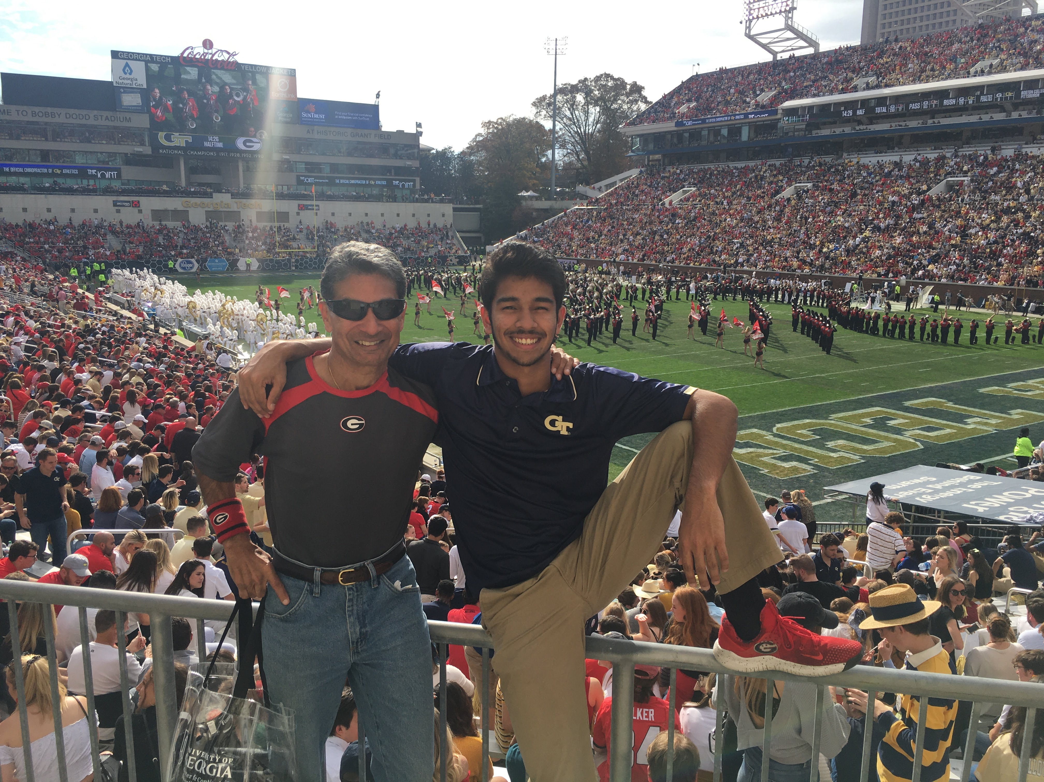
About me

Slide 3
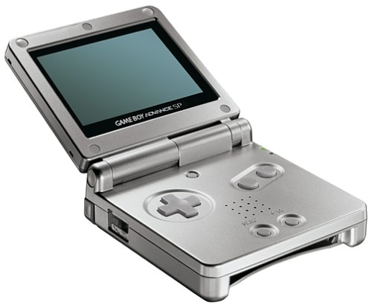
Intro to gba
First produced by Nintendo in 1989
Lacks concrete operating system
Convenient to use C code
Components:
Direct Memory Access (DMA)
Button Controller (10 total)
Video Controller
Audio Controller
Components ⬅➔Memory⬅➔Processor

Slide 4
GBA Tech Specs
240
ARM-7-TDMI 3 stage pipelined processor
Accepts chars (8-bit), shorts (16-bit), and ints (32-bit)
32-bit address space
Can use 16 or 32 registers at a time (assembly language)
Also used in Apple’s iPod, Nintendo DS, iRobot’s Roomba, and many automobiles
Buttons are single bit values (1 = pressed, 0 = not pressed)
Output Screen: 160x240 pixels
Colors represented by (R,G,B) values 0-31
Set each pixel to a color value
Video memory is 2D array stored by row-major order
Offset = row * cols + col = row * 240 + col
X [5,8]
160
0
0
0
0
0
0
0
0
0
0
0
0
0
0
0
0

Slide 5
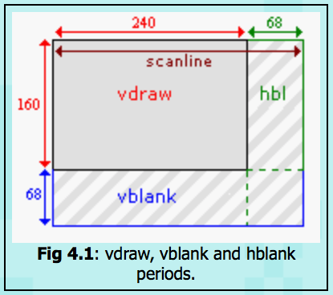
GBA video Screen Restrictions
GBA screen refresh rate is 60 Hz
Pauses in each drawing process for each scan line (1 per row = 160 lines)
Draw scanline = 240 pixels (across screen)
Horizontal blank (68 pixels)
Vertical blank (Vblank) = 68 scanlines
Must update positional data at each iteration of Vblank to avoid screen tearing
Most games run at 60fps
280896 cycles / 16.78 MHz clock speed ≈ 59.73 frames/sec

Slide 6
GBA/C Code conventions
Header files (file.h)
Declarations (0 storage allocation necessary)
Define macro functions (#define)
Function prototypes
#include for other .h header files, never .c files
Each code, image, and sound file has a .c (code) file and .h (header) file

Slide 7

My project
Football-style game representing annual UGA vs Georgia Tech football game
Objective: It’s 4th down on the last play of the game, and we must get Buzz (GT mascot) to endzone without Hairy (UGA mascot) tackling him!
Notes:
Big game for me bc I was raised as UGA fan by dad (alma mater) but now attend Gatech. I can safely cheer for GT bc I know UGA will win and it won’t affect their season.

Slide 8
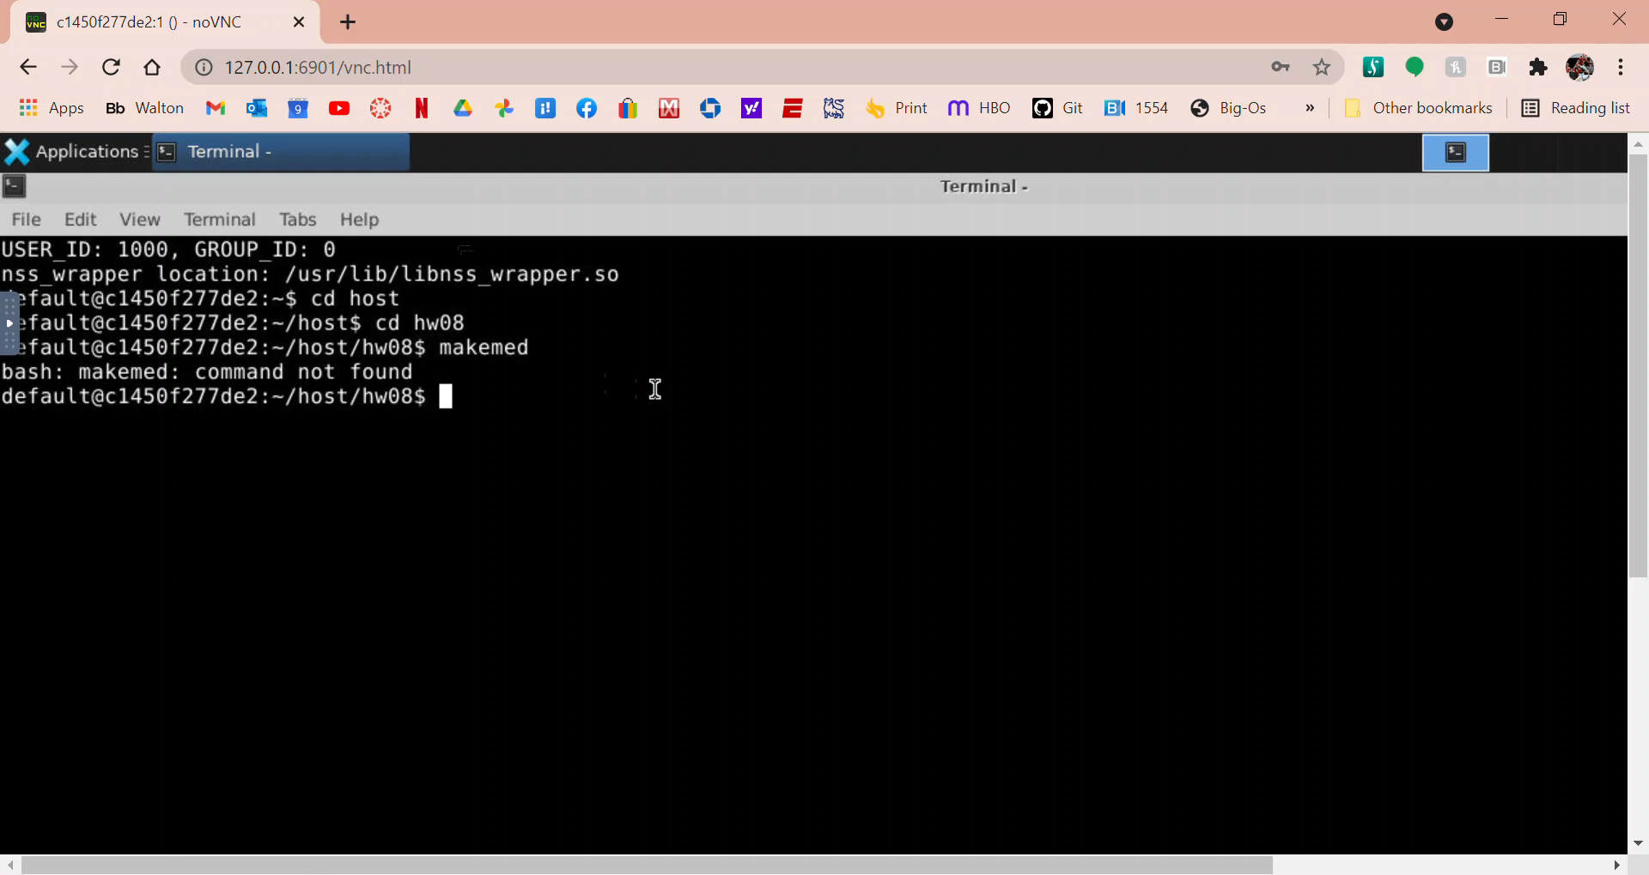
Gameplay

Slide 9
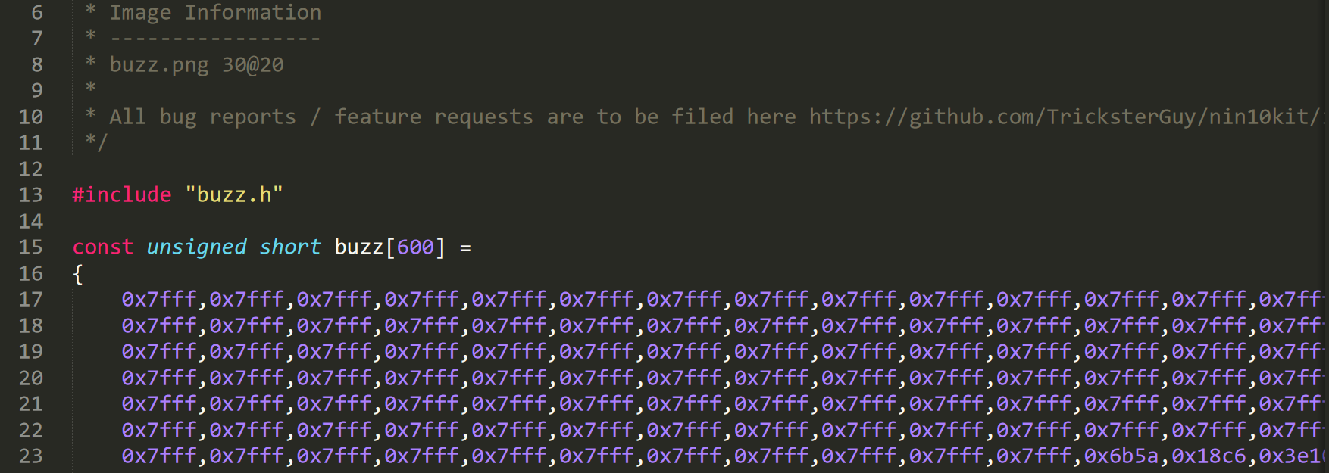
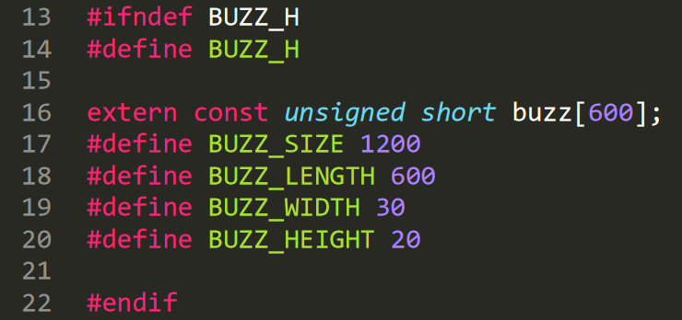
Code snippet: loading pictures
Buzz .c file: 20x30 pixels = 2D array 600 pixels
Each pixel is set to Hex color value
Buzz header file: outlines dimensions of image file
Defines properties of actual .png file, then size of picture on GBA screen (20*30)

Slide 10
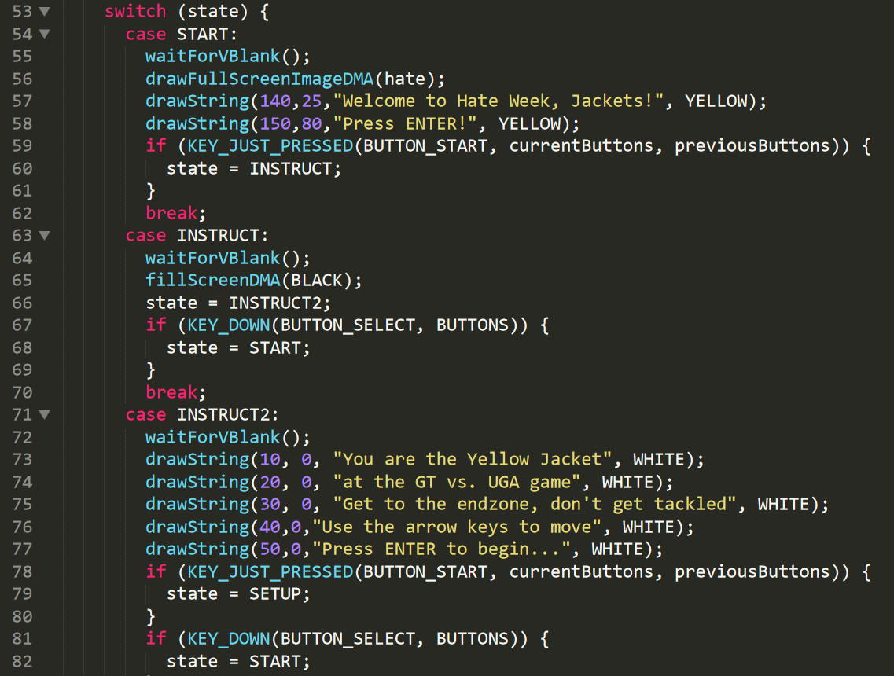
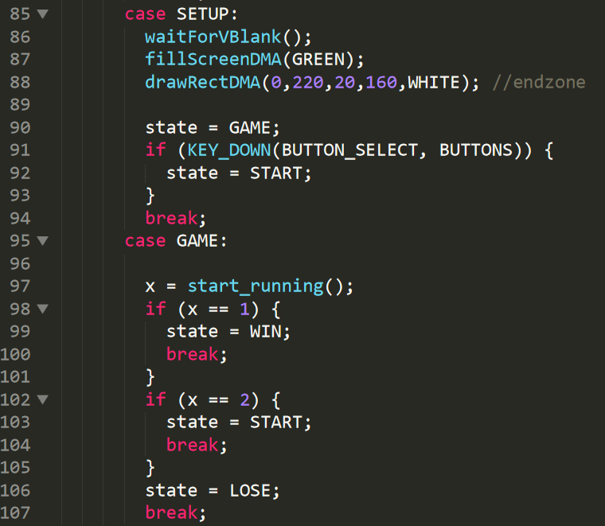
Code snippet: Screen Transitions
Transitions from start screen to first instruction screen to second instruction screen to starting game screen to game over screen (win/lose)
KEY_DOWN function takes in a selected button and an array of button choices to determine next state
waitForVBlank();
Notes:
waitForVBlank()!!!

Slide 11
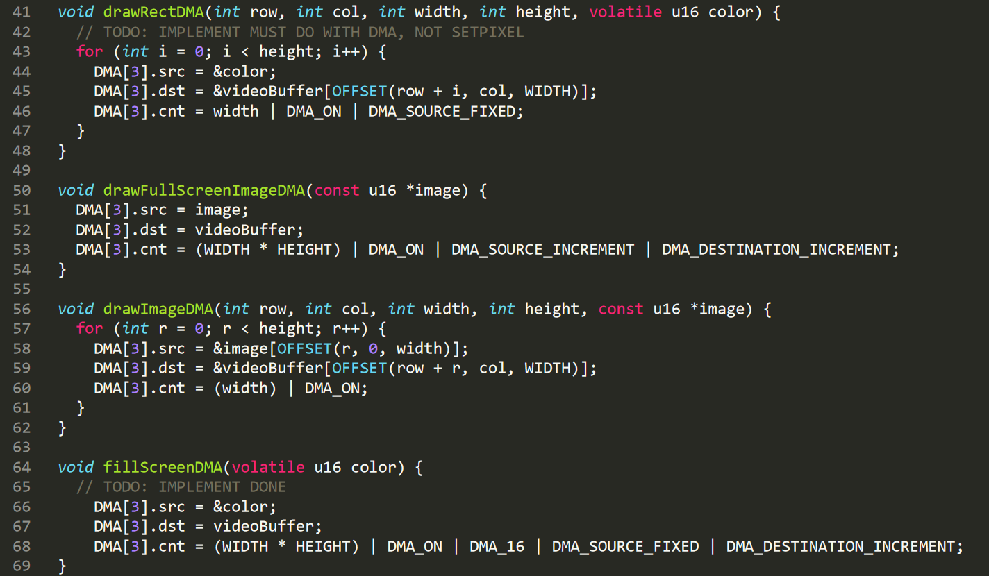
Code snippet: drawing functions
drawRectDMA draws a colored rectangle of w x h
drawFullScreenImageDMA makes the background a passed in image
drawImageDMA draws an image of w x h
fillScreenDMA fills the background with a color

Slide 12
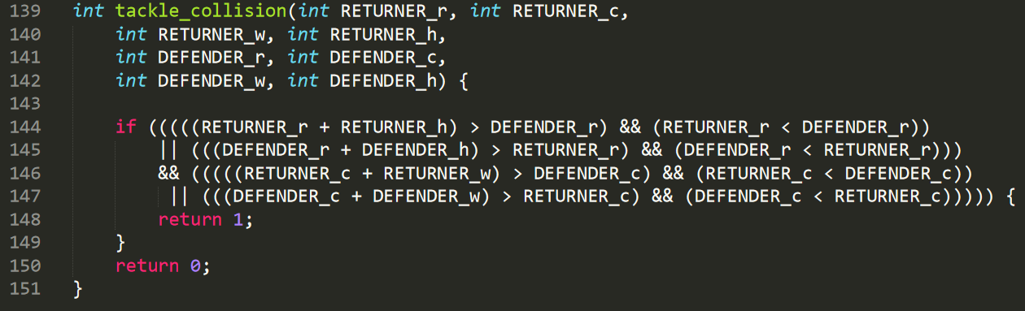
Code snippet: Collision code
Whenever Buzz (returner) collides with Hairy (defender) in any way, he gets tackled and the game is over
We test this with tackle_collision()
4 collision scenarios
Returner is above and behind defender
Returner is above and ahead of defender
Returner is below and behind defender
Returner is below and ahead of defender

Slide 13
Relation to tempus ex
C and GO both compile down to assembly language
Arrays in C correlate to slices in GO
Slices can hold varying amounts of data and be passed into functions by value without sacrificing any data or pointer attributes
Complex memory allocation processes make this possible

Slide 14
Further applications
Basic logic of GBA emulators are still used in modern sports videogames
GBA versions of EA Sports’ Madden 07 still available
1989 Nintendo GameBoy set the standard for mobile gaming
Collision code from game applies to position tracking used by sports cameras, sports analytics, and artificial intelligence robots

